Slide 1


PSG COLLEGE OF TECHNOLOGY
MULTI-LEVEL MODEL STACKING FOR HEART DISEASE PREDICTION
03/01/2022
HDP
Notes:
krithika

Slide 2
PROBLEM STATEMENT
The overall objective of this project will be to predict accurately the presence of heart disease using certain attributes.
Many more input attributes can be taken but our goal is to predict with few attributes and faster efficiency in predicting risk of having heart disease.
The predicted results can be used to prevent the cost for surgical treatment and other expenses
HDP
Notes:
k

Slide 3
SCOPE AND MOTIVATION
The system can discover and extract hidden knowledge associated with diseases from a historical heart data set.
Integration of clinical decision support with computer-based patient medical records could reduce medical errors, enhance patient safety, decrease unwanted practice variation, and improve patient outcome.
HDP
Notes:
k

Slide 4


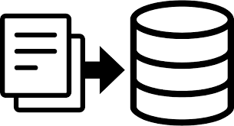
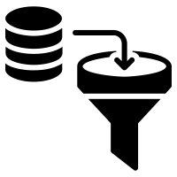

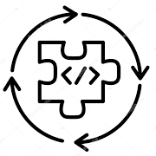
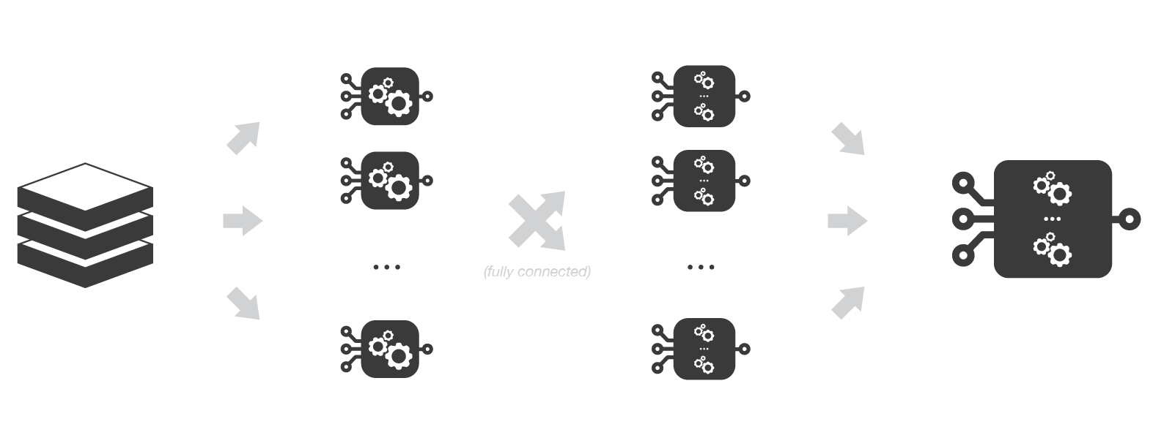
WORKFLOW
Dataset Collection
Dataset Pre-Processing
Model Identification and Training
Prediction
Model Construction
Ensemble Techniques
HDP
Notes:
Krithika

Slide 5
DATASET
Heart Disease UCI | Cardiovascular Disease dataset | Combined dataset
303 instances 13 features + target | 70000 instances 12 features + target | 1221 instances ( 303 + 1026 + 1091) 11 features + target
Age, sex, chest pain type, resting blood pressure, serum cholesterol, fasting blood sugar, resting electrocardiographic results, maximum heart rate achieved, exercise induced angina, oldpeak, slope, number of major vessels, thal | Age, Height, Weight, Gender, Systolic blood pressure, Diastolic blood pressure, Cholesterol, Glucose, Smoking, Alcohol, Physical activity | Age, sex, chest pain type, resting blood pressure, serum cholesterol, fasting blood sugar, resting electrocardiographic results, maximum heart rate achieved, exercise induced angina, oldpeak, slope
HDP
Notes:
krithika

Slide 6
IMPLEMENTATION
Heart Disease UCI | Cardiovascular Disease dataset | Combined dataset
Normalization- Min Max Normalization. | Normalization- Min Max Normalization. | Normalization- Min Max Normalization.
Cross Validation | Cross Validation | Cross Validation
Algorithms- K Nearest Neighbour, Decision Tree, Random Forest, Logistic Regression, Support Vector Machine, Deep Neural Networks, Naive Bayes. | Algorithms- K Nearest Neighbour, Decision Tree, Random Forest, Logistic Regression, Support Vector Machine, Deep Neural Networks, Naive Bayes. | Algorithms- K Nearest Neighbour, Decision Tree, Random Forest, Logistic Regression, Support Vector Machine, Deep Neural Networks, Naive Bayes.
Boosting - Adaboost, Xgboost, Gradient Boost. | Boosting - Adaboost, Xgboost, Gradient Boost. | Boosting - Adaboost, Xgboost, Gradient Boost.
Correlation Analysis Between Model | Correlation Analysis Between Model | Correlation Analysis Between Model
Multi level Stacking | Multi level Stacking | Multi level Stacking
Notes:
This are the implementations we have done so far starting from normalization of min max , cross validation and worked on the following supervised algorithms called knn, decision tree,random forest,logistic regression,support vector machine, deep neural networks and naive bayes we have done boosting to increase the accuracy using ada boost, xgboost,and gradient boosting and also correlation between each model is been analysed followed by stacking is been done

Slide 7
K Nearest Neighbour
Support Vector Machine
Decision Tree
SUPERVISED ALGORITHMS
Naive Bayes
Deep Neural Network
Logistic Regression
HDP
Notes:
This are the supervised models we have worked on starting from knn to support vector machines

Slide 8
ACCURACY FOR ALGORITHMS
DATASET | KNN | SVM | DT | NB | DNN | LR
Heart Disease UCI (303) | 80.5% | 82.8% | 76.5% | 80.5% | 81.9% | 82.1%
Combined Dataset (1221) | 70.8% | 73.9% | 67.8% | 71.3% | 58.1% | 71.9%
Cardiovascular Disease Dataset (70000) | 67.9% | 70.7% | 59.3% | 54.7% | 63.3% | 69.5%
We got higher accuracy in support vector machine (SVM)
HDP
Notes:
These are the accuries obtained from each model using different dataset
In heart disease uci dataset svm gave the highest accuracy of 82.8
In combined dataset 73.9% is the highest
Cardiovascular dieases dataset 70.7 is the highest
The inference obtained from the accuracy table is that svm gives our highest accuracy

Slide 9
PRECISION SCORE FOR ALGORITHMS
DATASET | KNN | SVM | DT | NB | DNN | LR
Heart Disease UCI (303) | 82.9% | 81.4% | 80.9% | 81.5% | 72.7% | 81.1%
Combined Dataset (1221) | 72.6% | 79% | 73.4% | 72.6% | 76.1% | 75.9%
Cardiovascular Disease Dataset (70000) | 70.7% | 74% | 58.5% | 77.1% | 58.7% | 70.8%
In precision score, Support vector machine (SVM) and K-Nearest Neighbor (KNN) gives high score
HDP
Notes:
In precision score
Knn gave the best score in hcui
In combined dataset dnn is highest
Cardiovascular in svm 74 is highest
In precision tree the score about from svm and knn is the highest

Slide 10
RECALL SCORE FOR ALGORITHMS
DATASET | KNN | SVM | DT | NB | DNN | LR
Heart Disease UCI (303) | 83.6% | 99.3% | 79.3% | 87.2% | 83.6% | 87.2%
Combined Dataset (1221) | 74.5% | 69.3% | 65.3% | 62.6% | 67.5% | 68.5%
Cardiovascular Disease Dataset (70000) | 61.2% | 40.7% | 54.2% | 75.9% | 52.2% | 66.2%
For recall score Support vector machine(SVM) and K-Nearest Neighbor (KNN) and Naive Bayes high recall score
HDP
Notes:
Similar to precision score in recall score also obtained the similar results obtaining 99.3% in svm and 74.5 in combined dataset

Slide 11
F1 SCORE FOR ALGORITHMS
DATASET | KNN | SVM | DT | NB | DNN | LR
Heart Disease UCI (303) | 82.3% | 84.9% | 78.6% | 82.4% | 81.3% | 87.2%
Combined Dataset (1221) | 73.1% | 70.7% | 68.4% | 67% | 50% | 68.5%
Cardiovascular Disease Dataset (70000) | 65.6% | 70.7% | 55.1% | 23% | 68.9% | 68.4%
Consider the datasets, each dataset gave high f1 score using different algorithms
HDP
Notes:
The f1score obtained in lr is gave higher value for huci
For combined dataset 73.1
Cardiovascular 70.7 is obtained

Slide 12
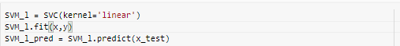
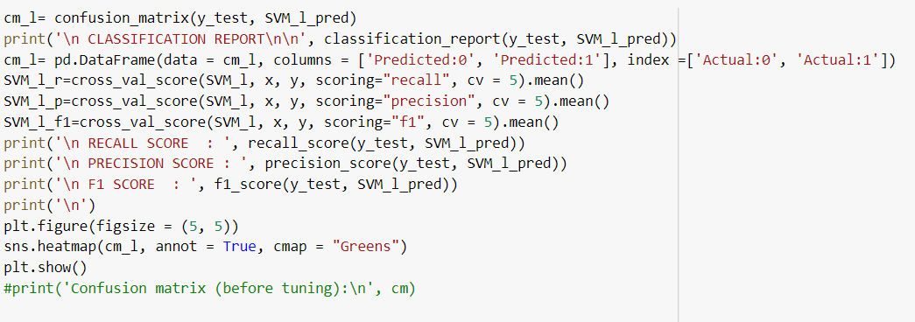
SUPPORT VECTOR MACHINE
Notes:
Since support vector machines gaves best results in the pervious scores, accuracy the code is as follows

Slide 13
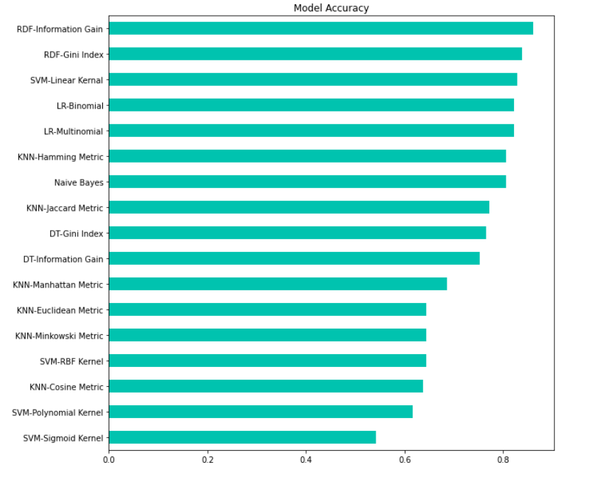
HEART DISEASE UCI (303 INSTANCES)
HDP
Notes:
t

Slide 14
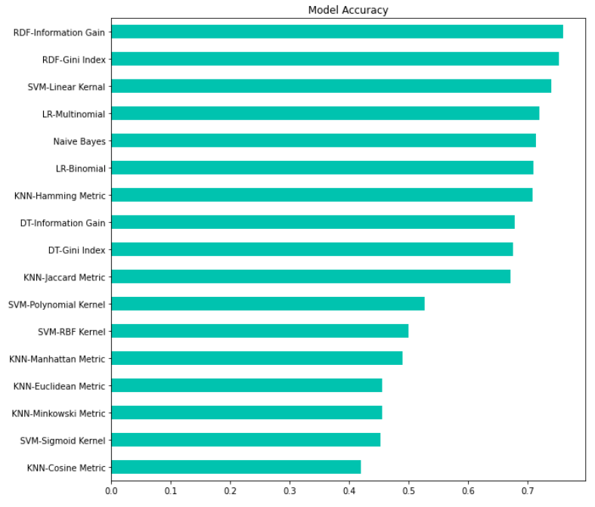
COMBINED DATASET (1221 INSTANCES)
HDP
Notes:
t

Slide 15
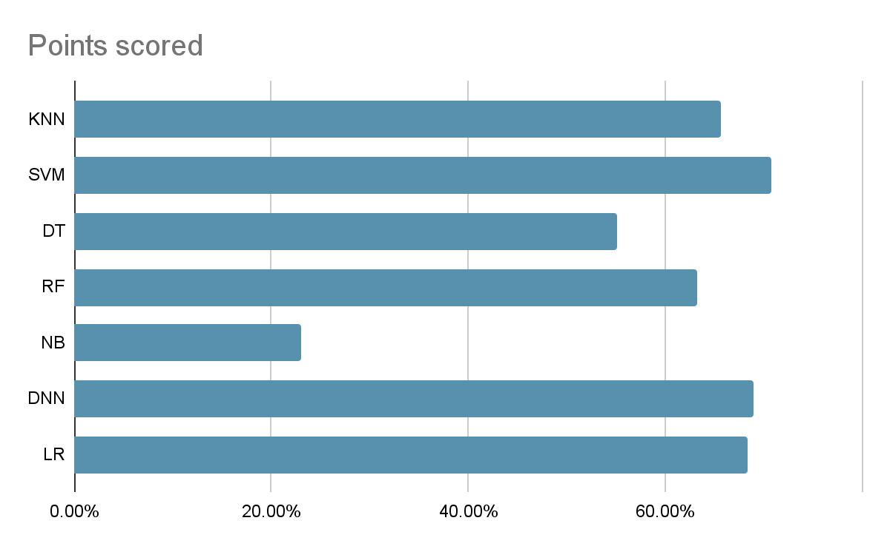
CARDIOVASCULAR DATASET (70000 INSTANCES)
HDP
Notes:
t

Slide 16
“One is weak, together is strong, learning from past is the best ”
ENSEMBLED TECHNIQUE
BOOSTING
BAGGING
ADABOOST
GRADIENT BOOST
XGBOOST
RANDOM FOREST

Slide 17
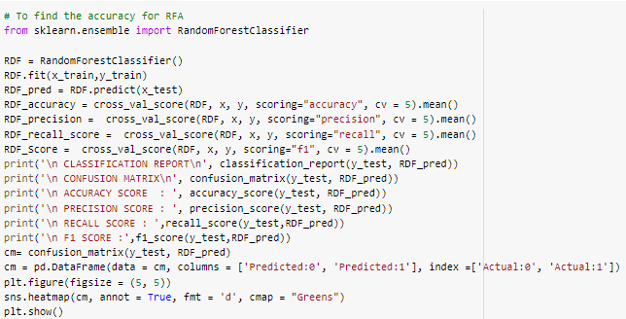
RANDOM FOREST

Slide 18
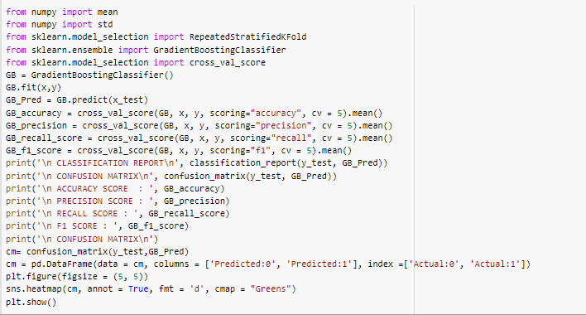
GRADIENT BOOST
HDP
Notes:
r

Slide 19
ACCURACY
DATASET | ADABOOST | XGBOOST | GRADIENT BOOST | RF
Heart Disease UCI (303) | 78.5% | 80.5% | 81.4% | 86%
Combined Dataset (1221) | 71.5% | 73.6% | 73% | 75.9%
Cardiovascular Disease dataset (70000) | 63.9% | 65.4% | 66.1% | 67.6%
We got higher accuracies in Random Forest
HDP
Notes:
r

Slide 20
PRECISION SCORE
DATASET | ADABOOST | XGBOOST | GRADIENT BOOST | RF
Heart Disease UCI (303) | 79.2% | 81.1% | 80.9% | 84.1%
Combined Dataset (1221) | 74.8% | 77.8% | 78.6% | 79.8%
Cardiovascular Disease dataset (70000) | 56.2% | 56.1% | 76.4% | 73%
We got higher precision in Random Forest
HDP
Notes:
r

Slide 21
RECALL SCORE
DATASET | ADABOOST | XGBOOST | GRADIENT BOOST | RF
Heart Disease UCI (303) | 83% | 84.8% | 86% | 84.6%
Combined Dataset (1221) | 72.2% | 71.9% | 69.6% | 73.9%
Cardiovascular Disease dataset (70000) | 59.6% | 61.5% | 61% | 69.8%
We got higher recall in Random Forest
HDP
Notes:
r

Slide 22
F1 SCORE
DATASET | ADABOOST | XGBOOST | GRADIENT BOOST | RF
Heart Disease UCI (303) | 80.8% | 82.5% | 83.2% | 85.5%
Combined Dataset (1221) | 72.5% | 73.5% | 72% | 76.1%
Cardiovascular Disease dataset (70000) | 56% | 70.4% | 57.2% | 63.2%
We got higher F1 Score in Random Forest
HDP
Notes:
r

Slide 23
STACKING MODEL
HDP
Notes:
tara

Slide 24
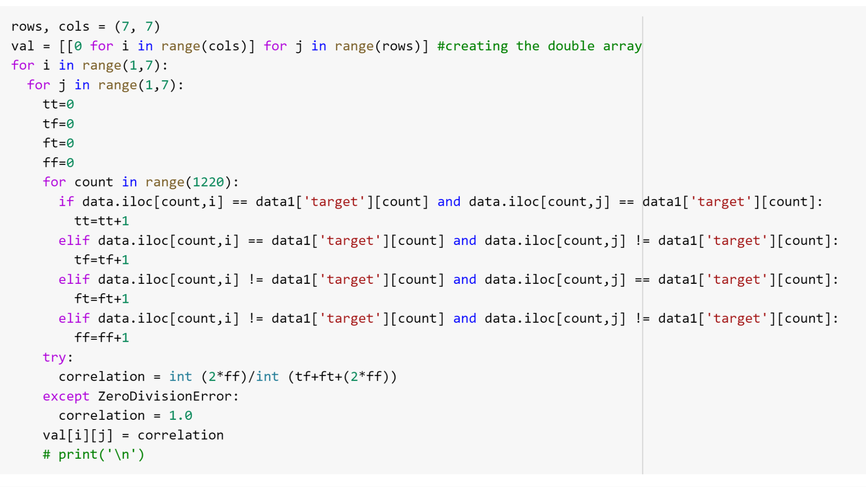
CORRELATION ANALYSIS

Slide 25
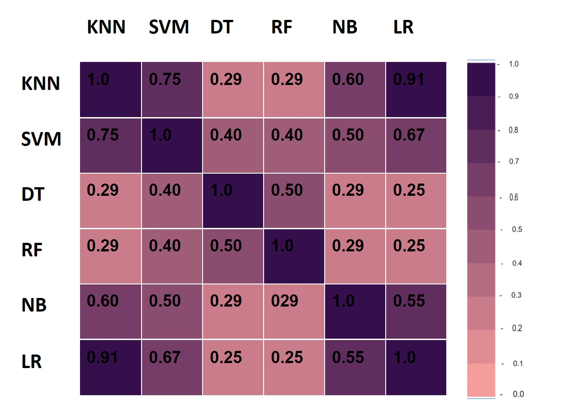
HEART DISEASE UCI (303 INSTANCES)
Notes:
krithika

Slide 26
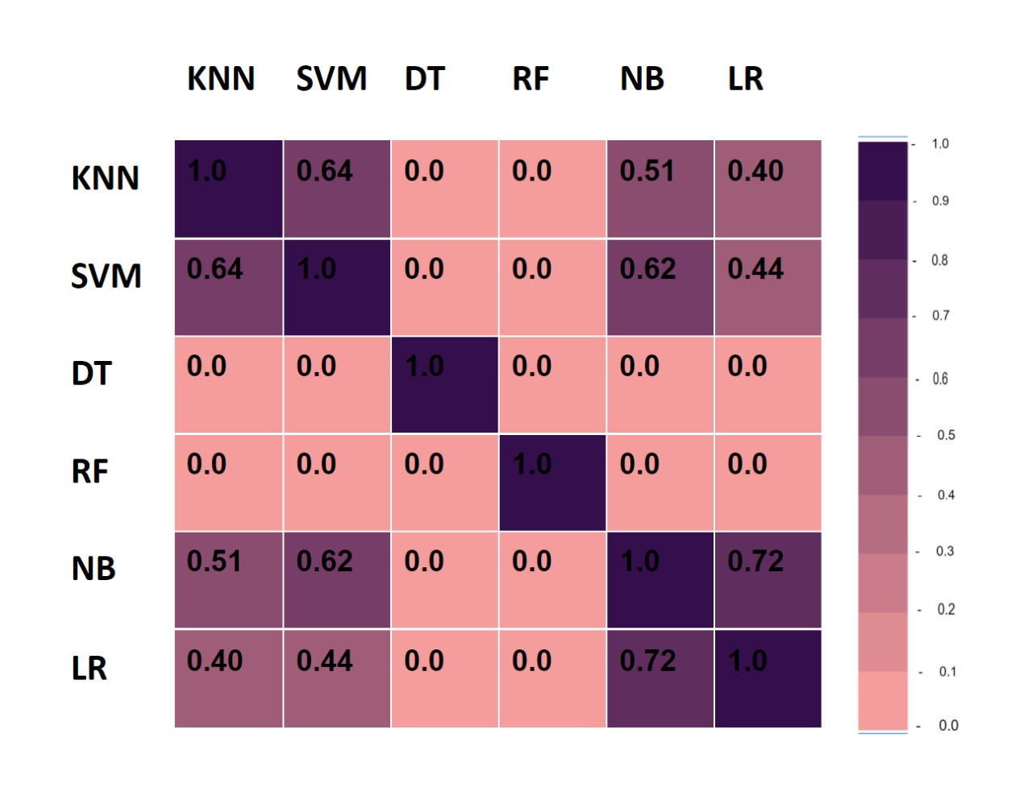
COMBINED DATASET (1221 INSTANCES)

Slide 27
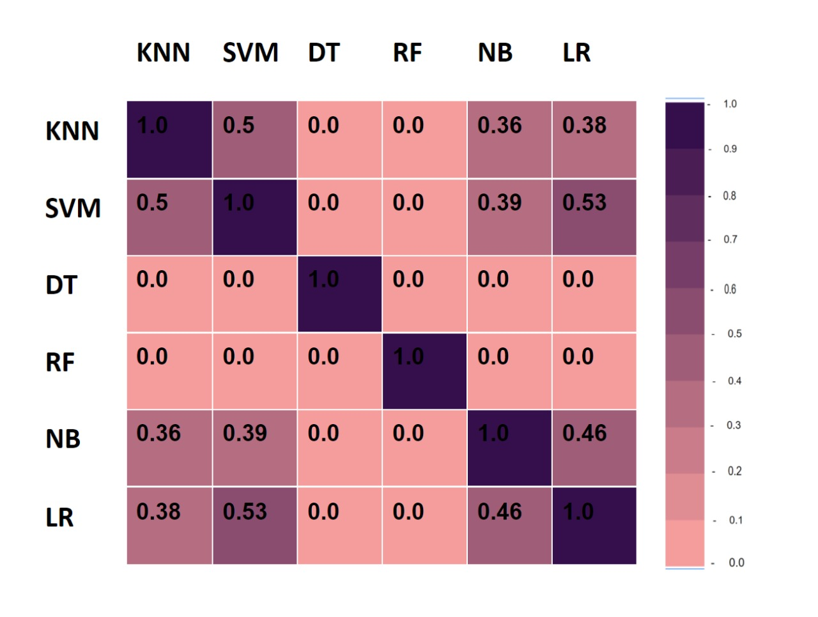
CARDIOVASCULAR DATASET (70000 INSTANCES)

Slide 28
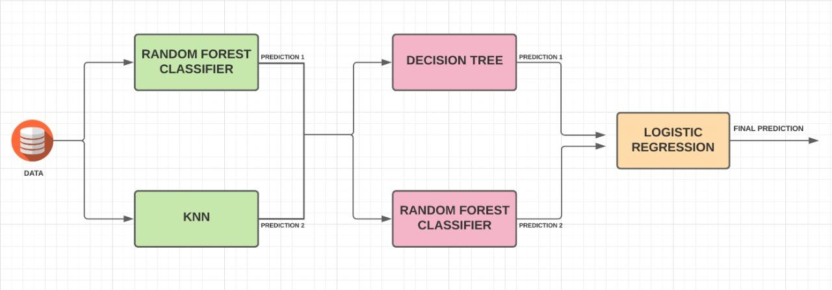
MULTILEVEL STACKING
HDP
Notes:
Kiki n raksha

Slide 29
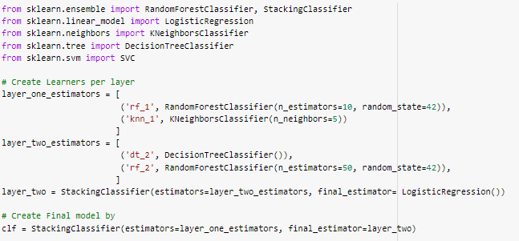
MULTILEVEL STACKING
HDP
Notes:
Kiki n raksha

Slide 30
MULTI LEVEL STACKING AFTER CROSS VALIDATION
DATASET | F1 SCORE | ACCURACY | PRECISION SCORE | RECALL SCORE
Combined dataset (1221) | 77.9% | 74.6% | 75.4% | 81.6%
Cardiovascular Disease dataset (70000) | 97.04% | 96.5% | 94.4% | 99.8%
HDP

Slide 31
MULTI LEVEL STACKING BEFORE CROSS VALIDATION
DATASET | F1 SCORE |  | ACCURACY |  | PRECISION SCORE |  | RECALL SCORE
 | Train data | Test data | Train data | Test data | Train data | Test data | Train data | Test data
Combined dataset (1221) | 93.7% | 93.5% | 93% | 92.6% | 92.3% | 91.6% | 95.1% | 95.6%
Cardiovascular Disease dataset (70000) | 97.4% | 97.3% | 97.4% | 97.3% | 98.6% | 98.3% | 96.2% | 96.3%
HDP

Slide 32
F1 SCORE BEFORE CROSS VALIDATION
DATASET | KNN | SVM | DT | RF | NB | LR | DNN | BOOST | STACKING
Combined Dataset (1221) | 73.1% | 84.9% | 63.5% | 82.9% | 75% | 78.4% | 50% | 85.8% | 93.7%(Train) 93.5%(Test)
Cardiovascular Disease dataset (70000) | 65.4% | 71.4% | 79.4% | 71.6% | 34.5% | 70.8% | 70.8% | 72.4% | 97.4%(Train) 97.3%(Test)

Slide 33
F1 SCORE AFTER CROSS VALIDATION
DATASET | KNN | SVM | DT | RF | NB | LR | BOOST | STACKING
Combined Dataset (1221) | 84.2% | 84.9% | 68.4% | 76.1% | 67% | 68.5% | 72.5% | 80.9%
Cardiovascular Disease dataset (70000) | 65.6% | 70.7% | 55.1% | 63.2% | 23% | 68.4% | 70.2% | 97.04%

Slide 34
ADD ON MODULE
Feature Selection | STACKING (303) | STACKING (1221) | STACKING (70k)
Pearson’s | 88.5% | 76.8% | 70%
LASSO | 85.20% | 82.35% | 79.27%

Slide 35
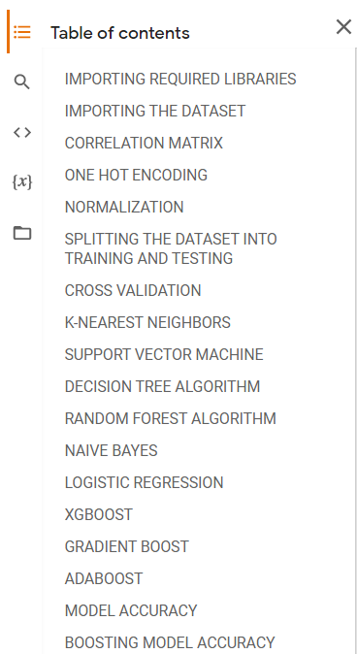
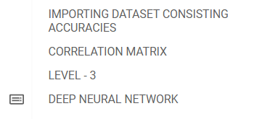
INFERENCE
Dataset with 70000 instances (Cardiovascular Dataset) gave us the best result
70.7% in support vector machine (f1 score)
70.2% in xg boosting (f1 score)
97.74% after multilevel stacking

Slide 36
TIMELINE CHART
TIMELINE | JUNE | JULY |  |  |  | AUGUST |  |  |  | SEPTEMBER |  |  |  | OCTOBER |  |  |  | NOVEMBER |  |  |  | DECEMBER
 | W 4 | W 1 | W 2 | W 3 | W 4 | W 1 | W 2 | W 3 | W 4 | W 1 | W 2 | W 3 | W 4 | W 1 | W 2 | W 3 | W 4 | W 1 | W 2 | W 3 | W 4 | W 1 | W 2 | W 3 | W 4
PROJECT FINALIZATION
SUPERVISED LEARNING MODELS AND ENSEMBLE TECHNIQUES
MULTI LEVEL STACKING
REPORT, PPT, ADD ON MODULE AND RESEARCH PAPER
- Planned - Completed - Work in progress
HDP
Notes:
s

Slide 37
REFERENCES
[1] Ms. Ishtake S. H , Prof. Sanap S.A, “ Intelligent Heart Disease Prediction System Using Data Mining Techniques ”, International J. of Healthcare & Biomedical Research, Volume: 1, Issue: 3, April 2013.
[2] Apurv Garg, Bhartendu Sharma,” Heart disease prediction using machine learning techniques”, IOP Conference Series Materials Science and Engineering, January 2021.
[3] Devansh Shah, Samir Patel, Santhosh Kumar Bharti,” Heart Disease Prediction using Machine Learning Techniques”, SN Computer science 1,Article Number: 345, October 2020.
[4] Animesh Kumar Dubey, Kavita Choudhary,” A systematic review and analysis of the heart disease prediction methodology”, International Journal of Advanced Computer Research, Volume: 8, Issue: 38, September 2018.
[5]Juan-JoseBeunz,EnriquePuertas,EsterGarcía-Ovejero,GemaVillalba,EmiliaCondes,GerganaKoleva,CristianHurtado,Manuel F.Landecho ,” Comparison of machine learning algorithms for clinical event prediction”, Journal Of Biomedical infomatic, Volume: 97, September 2019.
[6]Ashok Kumar Dwivedi, “Performance evaluation of different machine learning techniques for prediction of heart disease”, Neural Computing and Applications 29, September 2016
HDP
Notes:
s

Slide 38
[7] G. Parthiban, S.K.Srivatsa, “Applying Machine Learning Methods in Diagnosing Heart Disease for Diabetic Patients”, Foundation of Computer Science FCS, New York, USA, Volume 3– No.7, August 2012.
[8] Dubey, Animesh Kumar; Choudhary, Kavita, ” A systematic review and analysis of the heart disease prediction methodology”, International Journal of Advanced Computer Research; Bhopal Volume: 8, Issue: 38, September 2018.
[9]Harshit Jindal, Sarthak Agrawal, Rishabh Khera, Rachna Jain and Preeti Nagrath, ” Heart disease prediction using machine learning algorithms”, IOP Publishing Ltd, Volume: 1022, October 2020.
[10]V V Ramalingam, ”Heart disease prediction using machine learning techniques: A survey”, International Journal of Engineering & Technology, March 2018
[11] Maarten Grootendors,” Stacking made easy with Sklearn”, Dec 11, 2019.
[12]SaumyaAwasthi ,”Seven Most Popular Svm Kernels”,Data ScienceMachine Learning, December 17, 2020
[13]Nagesh Singh Chauhan, ”All you need to know about decision trees and how to build and optimize decision tree classifier ”, Data Science Enthusiast,
[14] NiklasDonges ,”A Complete Guide to the Random Forest Algorithm”, Expert Contributor Network, July 29, 2021.
HDP
Notes:
s

Slide 39
[15]Jason Brownlee,”Your First Deep Learning Project in Python with Keras Step-By-Step”,Deep Learning,July 24, 2019.
[16] Jason Brownlee ,”Multinomial Logistic Regression With Python”,Python Machine Learning,January 1, 2021
[17]Karan Bhanot,”Predicting presence of Heart Diseases using Machine Learning”, Feb 13 2019.
[18]Shruti Kothadia,”Classification algorithms in Python – Heart Attack Prediction and Analysis”, May 5, 2021.
[19]Siddharth1698,”Heart Disease Prediction using KNN -The K-Nearest Neighbours Algorithm”,Data Science Blogathon, July 10, 2021.
[9] Sarang Anil Gokte,” Most popular distance metrics used in knn and when to use them”, Praxis Business School, 2020.
[10]Usman Malik,” Implementing SVM and Kernel SVM with python’s scikit-learn ”,May 10,2019.
[11] Jason Brownlee,”How to Use StandardScaler and MinMaxScaler Transforms in Python” , Data Preparation, June 10,2020.
[12]Manish Pathak,” Using XGBoost in Python” , November 8th, 2019.
HDP
Notes:
s

Slide 40

[13]Burak Himmetoglu,”Stacking model for improved predictions“,UC Santa Barbara, Feb 2017.
[14]Deepika singh,”Finding Relationships in data with python“,Decision science analytics, Nov 12, 2019.
[15]Krisni,”K-Fold Cross Validation”,Dec16, 2018.
[16] Juhi Ramzai,” Clearly Explained: 4 types of Machine learning algorithms ”, May 2020.
[17] D Shah, S Patel, SK Bharti, “Heart disease prediction using machine learning techniques”, SN Computer Science volume: 01, Article number: 345 ,October .2020.
[18] Zaibunnisa L. H. Malik, Momin Fatema, Nikam Pooja, Gawandar Ankita, “Heart Disease Prediction using Artificial Intelligence”, IJERT Volume: 09, Issue: 04, May.2021.
Dataset link:
[1] Ronit ,”HEART DISEASES UCI”, June 25, 2018.
[2] Svetlana ulianova ,”Cardiovascular disease dataset”, 2019.
HDP
Notes:
s

Slide 41

THANK YOU!
HDP

